Slide 1
Secure Cloud Assisted Smart Cars
Maanak Gupta
Assistant Professor
Department of Computer Science
Tennessee Technological University
CAE Forum
November 13, 2019
mgupta@tntech.edu
www.maanakgupta.com

Slide 2
Cyber Security Landscape
Objectives
POLICY
ATTACKS
Enable
What?
Why?
Respond
Enforce
Defend
PROTECT
How?
DETECT
Mechanisms
Complement
Reference :
www.profsandhu.com

Slide 3
Cyber Security Landscape
Objectives
POLICY
ATTACKS
Enable
What?
Why?
Respond
Access Control
Enforce
Defend
PROTECT
How?
DETECT
Mechanisms
Complement
Reference :
www.profsandhu.com

Slide 4
Smart Cars Ecosystem
Safety and Assistance
High Mobility, Location Centric
Time Sensitive, Dynamic Pairing
Multiple Fog/Cloud Infrastructures
Information and Entertainment

Slide 5
No More Isolated.!
100 million lines of code
Software Reliance , Broad Attack Surface, Untrusted Entities

Slide 6
The Perfect World.!
operates on
(Read/write/execute/control)
USER
OBJECT
Confidentiality
Integrity
Availability
I TRUST my users.
Everything is Secure. !!

Slide 7
Access Control Mechanisms
Access Request
Access Control
Enforcer
GRANT DENY
USER
OBJECT
manages
ADMIN
A user [U] is allowed to perform an operation [OP] on an object [OB] if security policy [P] is satisfied.

Slide 8
Access Control Mechanisms
PROTECTION
Access Request
Access Control
Enforcer
GRANT DENY
USER
OBJECT
manages
Post Authentication
Complements other mechanisms
ADMIN
A user [U] is allowed to perform an operation [OP] on an object [OB] if security policy [P] is satisfied.

Slide 9
Attribute Based Access Control
Three Dominant Models: DAC, MAC and RBAC.
ABAC: Decision based on the attributes of entities
Attributes are name value pair: age (Alice) → 29
Core entities in ABAC include:
Users
Objects Attributes
Environment or Context
Operations
Authorization Policies: determine rights just in time
retrieve attributes of relevant entities in request
Enhance flexibility and fine grained access control
NIST Guidelines to ABAC
Notes:
User:---age, gender, department, desingatin, role
Object: created by, last modified,
Only nurse in the pediatric department is allowed to read the files of children which visit the clinic.
Only owner iot.

Slide 10
Access Control Needs in Smart Cars
On-Board Data, Applications and Sensors
Third Party devices
V2X fake messages
User Privacy Preferences
Over the Air updates
Loss of Information in Cloud
Location and time sensitivity of the services.
In-vehicle communication

Slide 11
Extended Access Control Oriented Architecture
E-ACO architecture
Vehicular IoT components in architecture

Slide 12
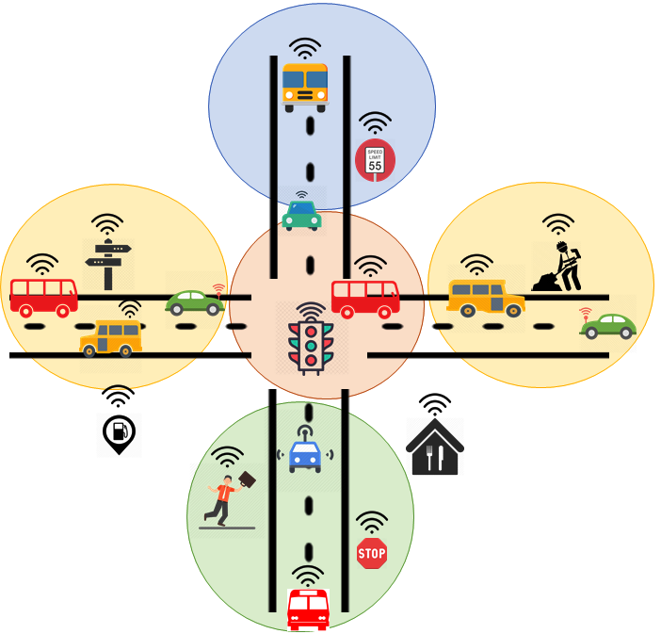
Attributes and Alerts
Speed Limit: 50 mph
Deer Threat: ON
Ice on Road: NO
Speed Limit: 30 mph
Flood Warning: ON
Road Work: ON
Speed Limit: 20 mph
School Zone: ON
Amber Alert: ABC123
Vehicle moves and are assigned to different groups and inherits their attributes/alerts.

Slide 13
Using Location Groups
Administrative Questions:
How the attributes or alerts of groups are updated?
How are moving entities assigned to groups?
How groups hierarchy is created?
Operational Questions:
How attributes and groups are used to provide security?
How user privacy preferences are considered?
Speed Limit: 50 mph
Deer Threat: ON
Ice on Road: NO
Speed Limit: 30 mph
Flood Warning: ON
Road Work: ON
Reported MQTT message
Notes:
How to realize dynamic location groups and how it works?

Slide 14
CV-ABAC_{G} Model

Slide 15
Model Components
user, sensor, car, mechanic, restaurant
{ location, size, IP, direction, speed, VIN, cuisine-type}

Slide 16
Model Components
{ read, write, control, notify, administrative actions }

Slide 17
Model Components
Cars, traffic lights, smart-devices
Sensor, ECU,
on-board apps
Location groups, service-specific, vehicle-type

Slide 18
Model Components
Operational and Administrative Activities
{notification, alerts, group hierarchy updates}
System Wide Policies
Individualized Privacy Policies

Slide 19
Formal Specification
Attribute Function
Attribute Type
Group Hierarchy
Attribute Mapping

Slide 20
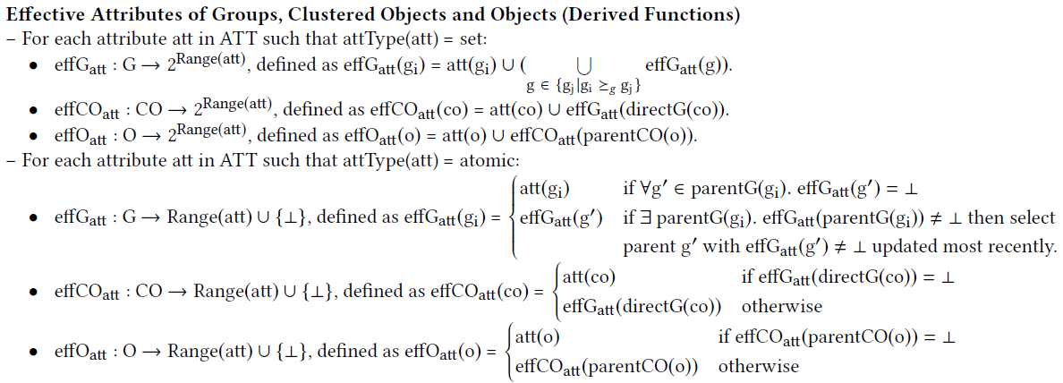
Formal Specification
Attributes more Dynamic
Attributes Inheritance

Slide 21
Policy Language
Administrators in the police department can send alert to location-groups in city limits.
Auth_{alert}(u:U, g:G) :: dept (u) Police ʌ parent-city(g) = Austin ʌ
Austin $∈jursidiction \left(u\right).$
Only mechanic in the technician department from Toyota-X dealership must be able to read sensor in Camry LE. Further, this operation must be done between time 9 am to 6 pm.
Auth_{read}(u:U, co:CO) :: role (u) Technician ʌ employer(u) = Toyota-X ʌ
make (co) = Toyota ʌ model(co) = Camry LE ʌ
operation_time(u) $∈$ {9am,10,11…6pm}

Slide 22
Activity Authorization Decision
Evaluate all relevant policies to make a decision
A restaurant in group A must be allowed to send notifications to all vehicles in location group A and group B.
System defined
DECISION
I only want notifications from Cheesecake factory.
User Preference

Slide 23
Implementation in Amazon Web Services (AWS)

Slide 24
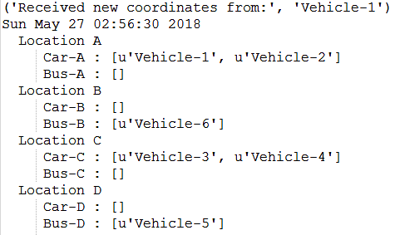
Vehicles and Groups
4 Location Groups
(static demarcation)
Vehicles movement
(coordinates generated using Google API)
Snapshot (table keeps changing)

Slide 25
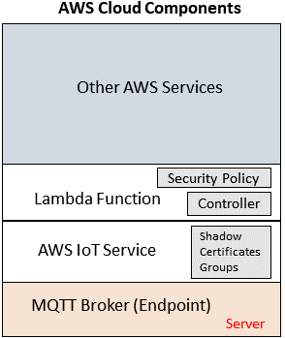
AWS Architecture

Slide 26
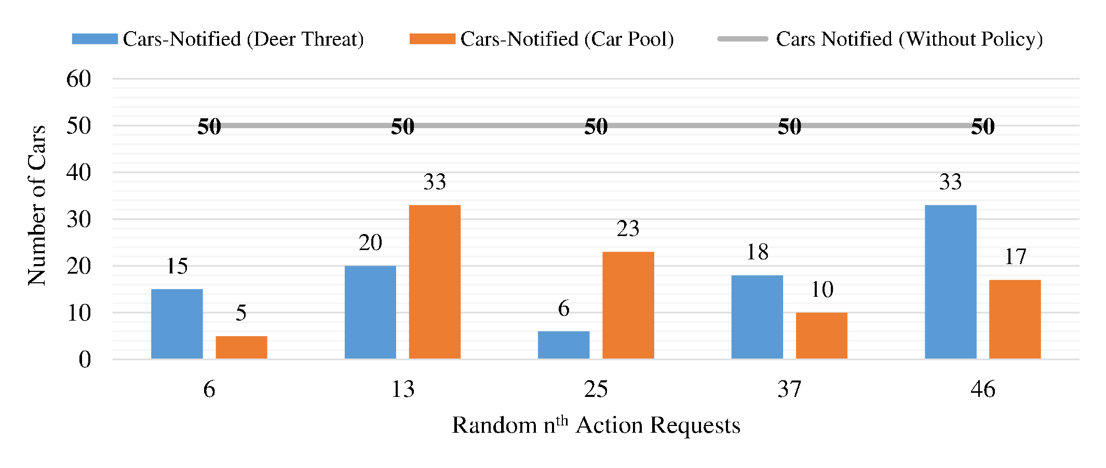
Performance Metrics

Slide 27
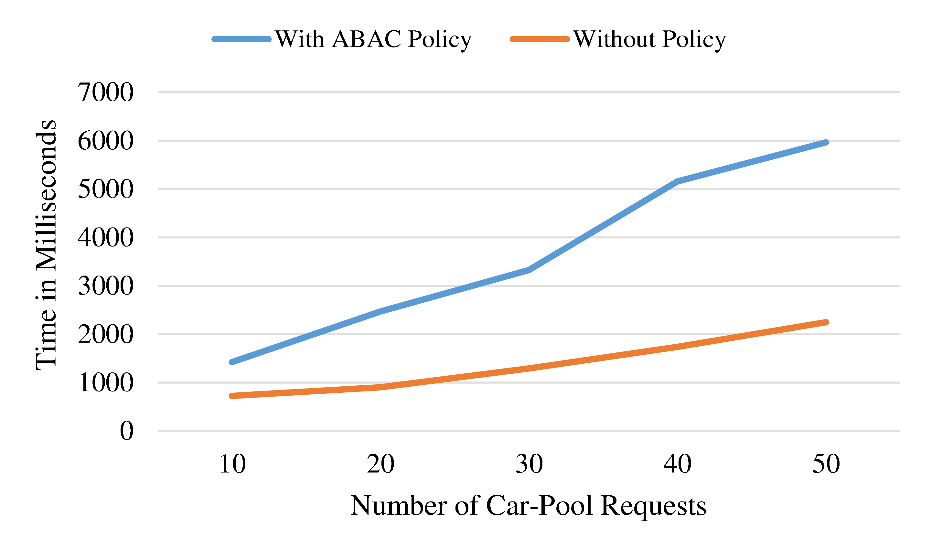
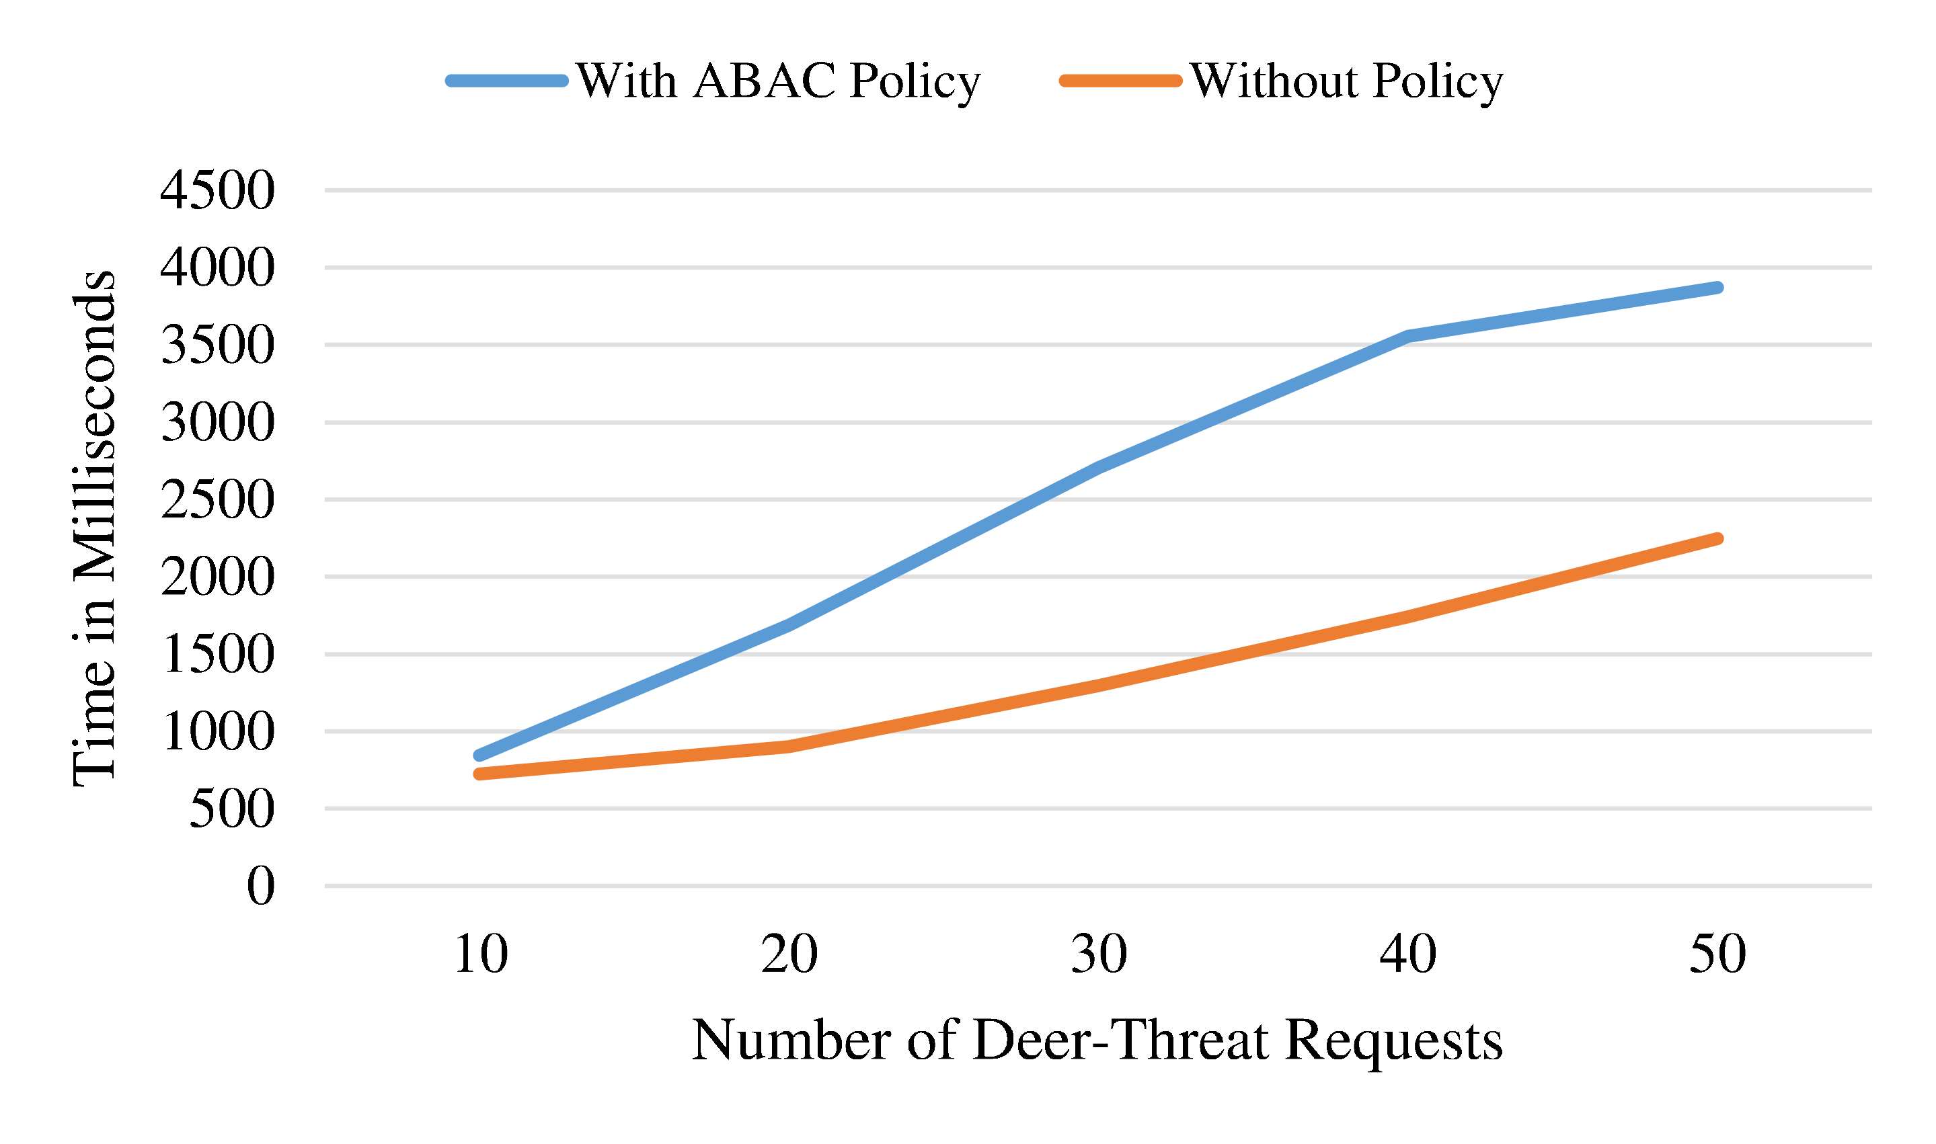
Performance Metrics

Slide 28
Let’s Talk ..!!
Questions, Comments or Concerns
mgupta@tntech.edu
www.maanakgupta.com

