Slide 1
Content Management lifecycle
There is no delete button
Mrs. Stacey Lee-Curbean
University of Maryland University College

Slide 2
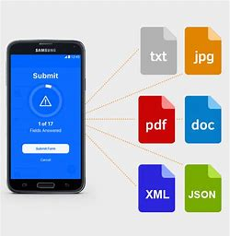
WHAT IS CONTENT?
Content
Published and Digital
Structured and Unstructured
Created with/without user’s knowledge
Communication Channels for Content
Social Media Sites
LinkedIn, Facebook, Snapchat, Instagram, Google+
Applications
Chat Rooms
Blogs
Dating Websites
Amazon
Google

Slide 3
Technological advancements
Smarter Devices and Computers
Social Media
Data Collection Software Improvements
Data Analysis Software Enhancements
Big Data
Internet of Things (IoT)

Slide 4
Internet of things (IoT)
Huge network of connected devices
Relationships between people and web-enabled devices
Devices includes tablets, cellphones, refrigerators, headphones, wearable devices, jet engines, and the like
Gartner has predicted there will be over 26 billion connected devices by 2020 (Gartner, 2013)
IoT produces an enormous amount of data that poses security and privacy risks

Slide 5
Digital footprint
A unique set of digital activities
Passive Footprint
Time-based
Logged in to complete a specific activity
Examples: Amazon, Macys
Active Footprint
Continuous
Logged in continuously; not necessarily to complete a specific activity
Examples: Facebook, Twitter, LinkedIn, SnapChat, eHarmony, Blogs, YouTube, Email
Why important?
Used for
Employment
Used for some colleges
Security Clearances

Slide 6
content management lifecycle
Content has a life cycle
Begins when data is created
Ends with destruction (from original source of collection) or permanent storage (where no longer used)
Content Management Lifecycle 5 Phases
Collection
Management
Storage
Delivery
Preservation

Slide 7
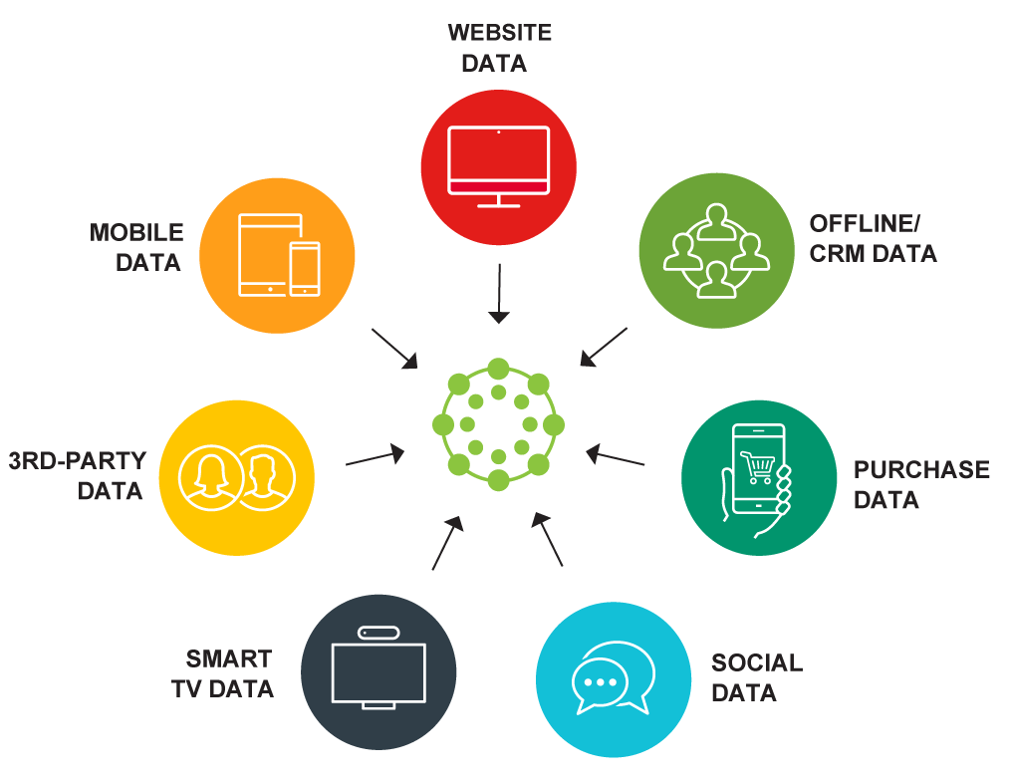
Collection

Slide 8
management
S. – (Know the Source)
U. – (Understand what private information is being collected)
R. – (Research what, why, how, & who)
E. – (Evaluate if you need to provide your private information)
Content Management is YOUR responsibility
Be S.U.R.E.
Personally Identifiable Information
Before providing information online, find out
What information is collected
Why the information is being collected
How information is shared
Who will have access to your information

Slide 9
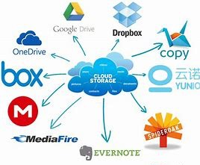
storage
Computer
CD/DVD
Database/Data Warehouse
Cloud
Server
Mobile and Portable Storage Devices

Slide 10
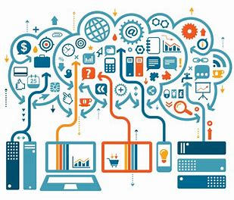
delivery
Paper
Internet
Intranet
Email
Mobile Devices
Fax
Portal
E-Statements

Slide 11
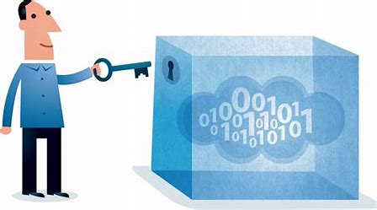
preserve
Archive
Backup
Paper

Slide 12
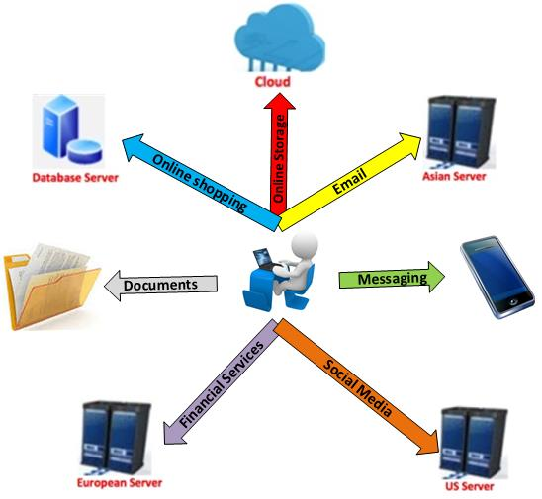
Where is your information

Slide 13
Protecting your information
Secure Information Offline
Keep personal information in safe place
Limit what you carry
Lock and password protect your computers
Safe disposal of computer and mobile devices
Secure Information Online
Encrypt data
Use strong passwords and keep private
Limit personal information shared on social media
Two-Factor Authentication

Slide 14
Protecting your information
Secure Devices
Keeps devices on your person and password protected
Use security software
Avoid Phishing Emails
Verify mobile apps before installing
Secure Laptops, mobile devices, and portable devices
Read privacy policies
Limit use of public Wi-Fi

Slide 15
Questions

Slide 16
references
Gartner (2013). Gartner says the Internet of Things installed base will grow to 26 billion units by 2020. Retrieved from https://www.gartner.com/newsroom/id/2636073

