Slide 1



Development of the Cybersecurity Skills Index (CSI): A Scenarios-Based, Hands-On Measure of Non-IT Professionals’ Cybersecurity Skills
Yair Levy
Nova Southeastern University
Ft. Lauderdale, FL
Melissa Carlton
Florida State University
Panama City, FL

Slide 2
Overview
Problem Statement
Research Main Goal
Research Questions
Review of the Literature
Methodology
Results
Contributions & Implications
Future Research

Slide 3
Problem Statement
The problem that this research addressed is the threats to organizational Information Systems (IS) due to vulnerabilities and breaches caused by employees (Hovav & Gray, 2014; Jensen et al., 2014; Peha, 2013)
The protection of IS lie in the most vulnerable spot; that vulnerability usually rests in individuals (Hovav & Gray, 2014)
Even with embedded Information Technology (IT) security tools working well, the non-IT user may still receive a social engineering message that can hook them into making mistakes due to low cybersecurity skills (Algarni et al., 2014; Axelrod, 2006; Winkler & Dealy, 1995)

Slide 4
Research Main Goal
Design, develop, and empirically test a set of hands-on tasks to measure the cybersecurity skills level of non-IT professionals

Slide 5
Main Research Question
What tasks will enable the validation of a hierarchical measure for observable cybersecurity skills of non-IT professionals?

Slide 6
Research Questions
RQ1: What are the specific subject matter experts (SMEs) identified set of cybersecurity skills of non-IT professionals, which address the most common organizational cybersecurity threats?
RQ2: What are the specific SMEs identified tasks that can be categorized, linked, and validated to the set of the identified cybersecurity skills?
RQ3: What are the specific SMEs identified weights of the tasks and skills that enable a validated hierarchical aggregation to the Cybersecurity Skills Index (CSI) benchmarking index?

Slide 7
Research Questions
RQ4: What are the scores of the CSI benchmarking index for the aggregated set of SMEs identified cybersecurity skills of a group of non-IT professionals?
RQ5: Are there any significant differences to CSI based on age, gender, educational level, job function, primary online activity, hours accessing the Internet, or experience with technology?

Slide 8
Review of the Literature
Skills and Competencies
  Skills Defined
  Competence vs. Skills
  Information Technology Skills
Data Breaches
  Social Engineering
  Malware
  Personally Identifiable Information
    Phishing
    Social Media
  Work Information Systems Security
    Confidential Information Exposure
    Password Exploitations
Cybersecurity
  Cybersecurity Skills Shortage
  Cybersecurity Risk Mitigation and Tools

Slide 9
Skills and Competencies
Skills are defined as the combination of knowledge, experience, and ability to do something well (Boyatzis & Kolb, 1991)
Cybersecurity skills are defined as an individual’s technical knowledge, experience, and ability surrounding the hardware and software required to execute information security in protecting their IT against damage, unauthorized use, modification, and/or exploitation (Boyatzis & Kolb, 1991; Choi, Levy, & Hovav, 2014)

Slide 10
Skills and Competencies
College coursework disseminates knowledge and is relevant to the competency level of a student (Eschenbrenner & Nah, 2014; Rubin & Dierdorff, 2009)
Vital for an organization that relies on its employees to possess skills (i.e., knowledge, experience, & ability) to complete technical tasks (Downey & Smith, 2011)
Information Technology (IT) skills are measured predominantly based on self-reported survey instruments (Levy, 2005; Torkzadeh & Lee, 2003)

Slide 11
Data Breaches
Prior research identified the need for research to address the threats to organizational IS due to vulnerabilities and breaches caused by employees (Choi et al., 2013; Jensen et al., 2014; Peha, 2013)
Since 2003, four of the top nine security incident patterns (e.g., miscellaneous errors, crimeware, insider misuse, & physical theft/loss) involved human error or misuse (Verizon Enterprise Solutions, 2015)
Cyber threats and vulnerabilities are causing substantial losses for individuals, organizations, and governments around the world (Levy, Ramim, Furnell & Clark, 2011; Ramim & Levy, 2006)

Slide 12
Cybersecurity Skills Shortage
Ponemon Institute (2014) found the IT security function understaffed at 70% of organizations surveyed
People that want to use their cybersecurity skills for good and not evil are difficult to locate (Rastello & Smialek, 2013)
People with good cybersecurity skills may be used in many related specialties; all do not obtain a computer science degree (Libicki et al., 2014)

Slide 13
Cybersecurity Risk Mitigation and Tools
Cybersecurity involves both technical and human ability “to protect or defend against cyber-attacks” (Committee on National Security Systems (CNSS), 2010, p. 22).
According to Maxion and Reeder (2005), risk mitigation is necessary to protect IS systems as humans making mistakes compromise IS security.
Executive Order 13,636 (2013) summons for the making of the ‘Cybersecurity Framework’ that includes “a set of standards, methodologies, procedures, and processes that align policy, business, and technological approaches to address cyber risks” (p. 11741).

Slide 14
Methodology
Development Research
  Address the problem
    Construct Cybersecurity Skills Index (CSI)
    Operationalized into the MyCyberSkills™ iPad app prototype
Sequential-Exploratory Design
  Qualitative
  Quantitative

Slide 15
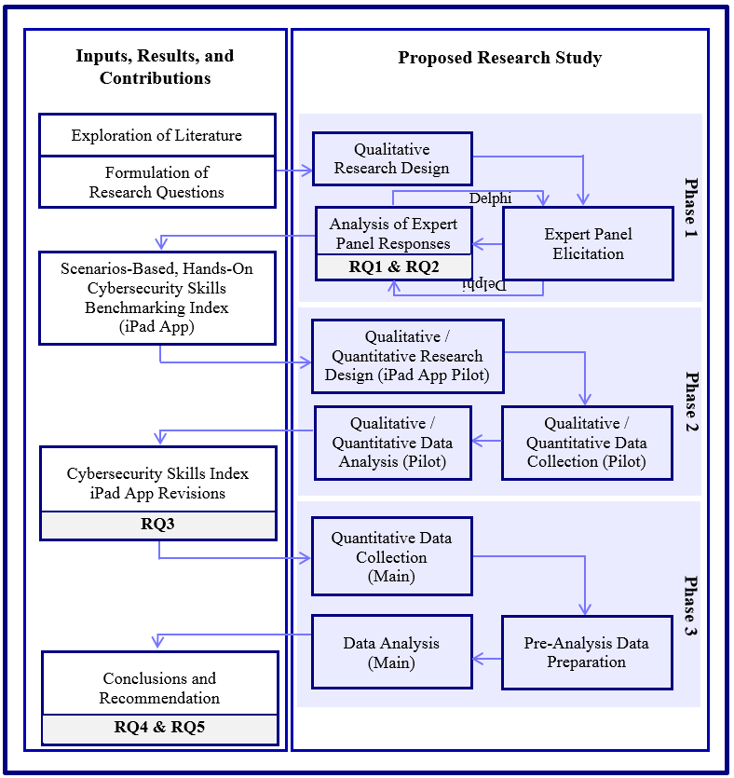
Overview of the Research Design Process

Slide 16
Results
Phase One
  Survey of existing body of knowledge
    Began with 12 cybersecurity threats
  Delphi Technique - Round One
    18 Subject Matter Experts (SMEs)
      Florida Chapter of the InfraGard
      Government
      Industry

Slide 17
Results (cont.)
Phase One continues
  Delphi Technique - Round Two
    Previously identified independent cybersecurity threats
      Seven-point Likert scale
        ‘1’ – strongly disagree & ‘7’ – strongly agree
        Valid to be included in core fundamental set
        Each proposed matching skill is valid or not
        Each proposed skill is independent of the others
        Rank highest threat a ‘1’ and lessor threat a ‘10’
  Consensus of SMEs’ opinion emerged

Slide 18
Results (cont.)
Phase One continues
  SMEs’ identified top nine cybersecurity skills established the CSI
  CSI operationalized into an iPad app prototype
    36 Scenario-based, hands-on tasks
    Score 0 - 100

Slide 19
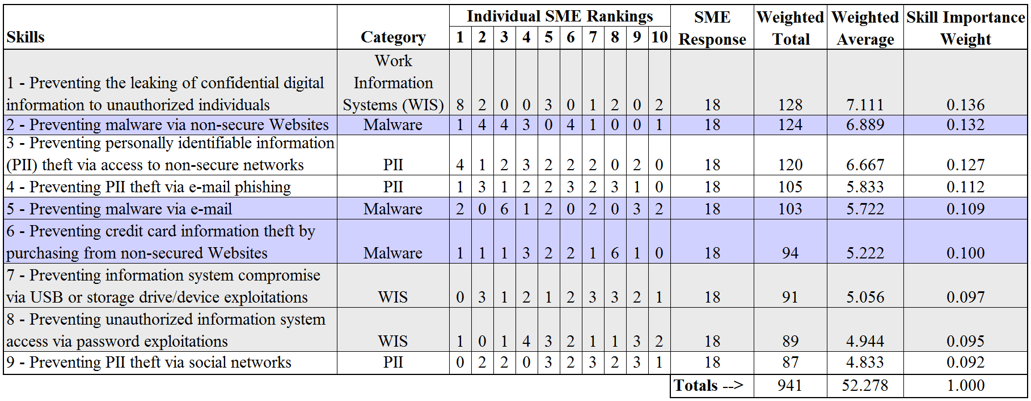
Results (cont.)
  SMEs’ Rankings of the Top Nine Cybersecurity Skills

Slide 20
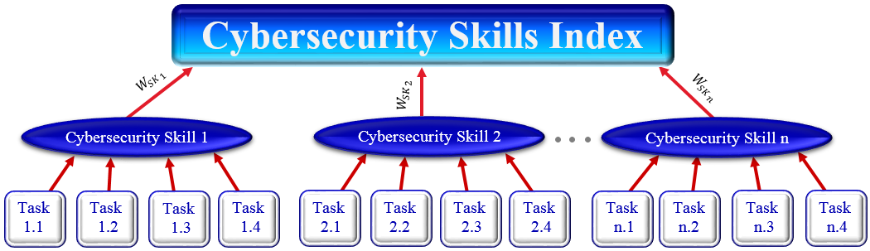
Conceptual Design of the CSI as an iPad App

Slide 21
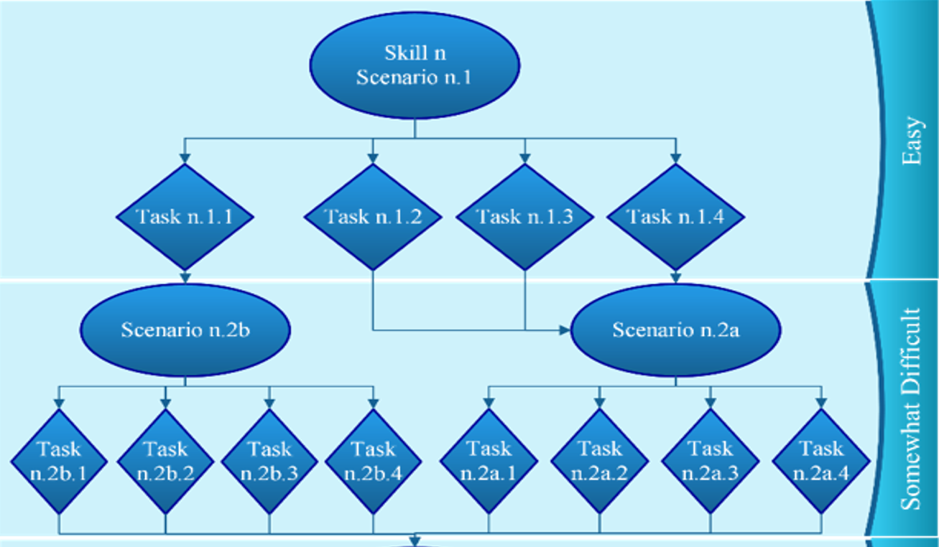
Scenario-Based, Hands-On Task
Skill Levels

Slide 22
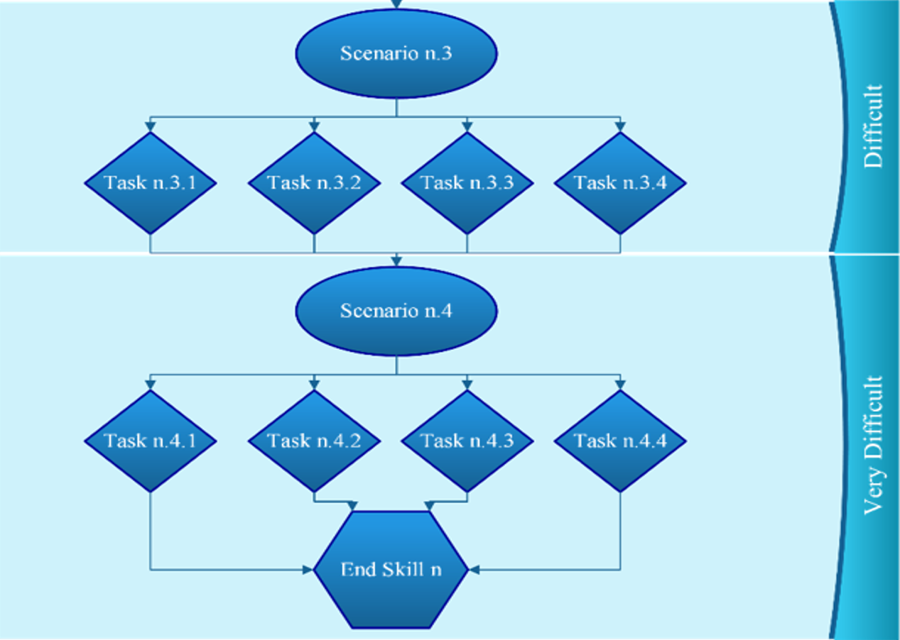
Scenario-Based, Hands-On Task
Skill Levels

Slide 23
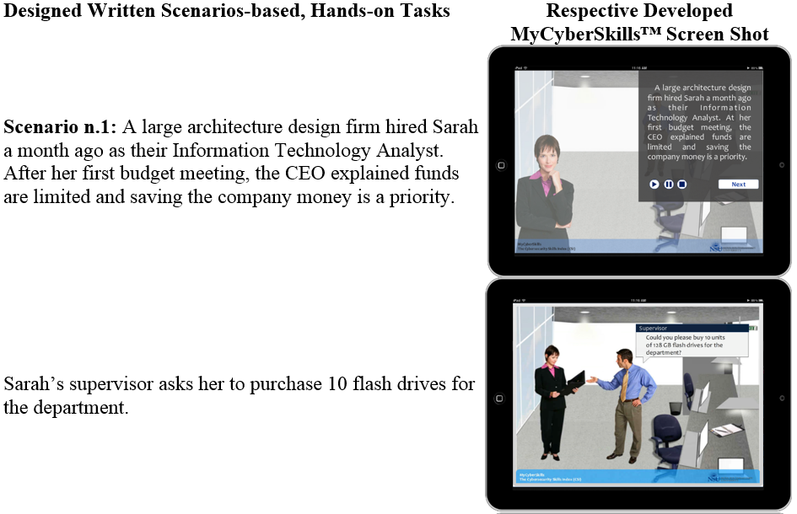
MyCyberSkills™ Prototype
Skill n – Preventing malware via non-secured Websites

Slide 24
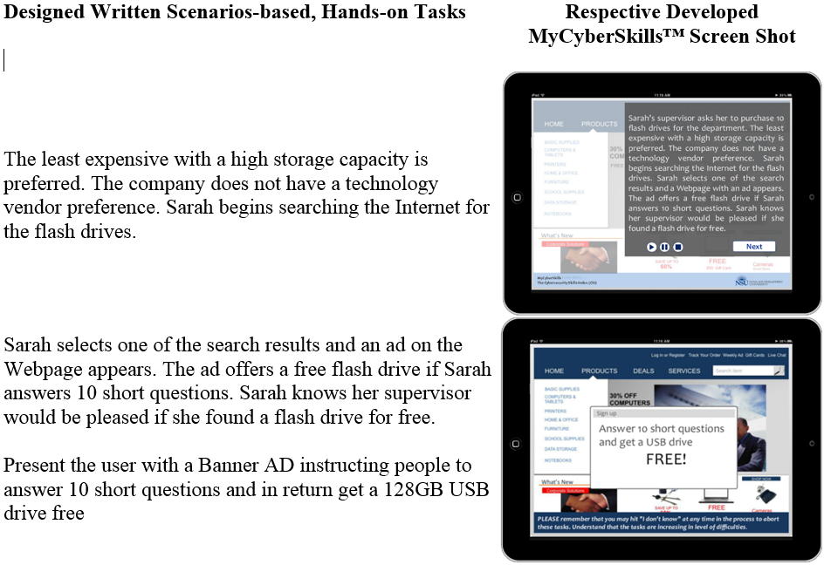
MyCyberSkills™ Prototype
Skill n – Preventing malware via non-secured Websites

Slide 25
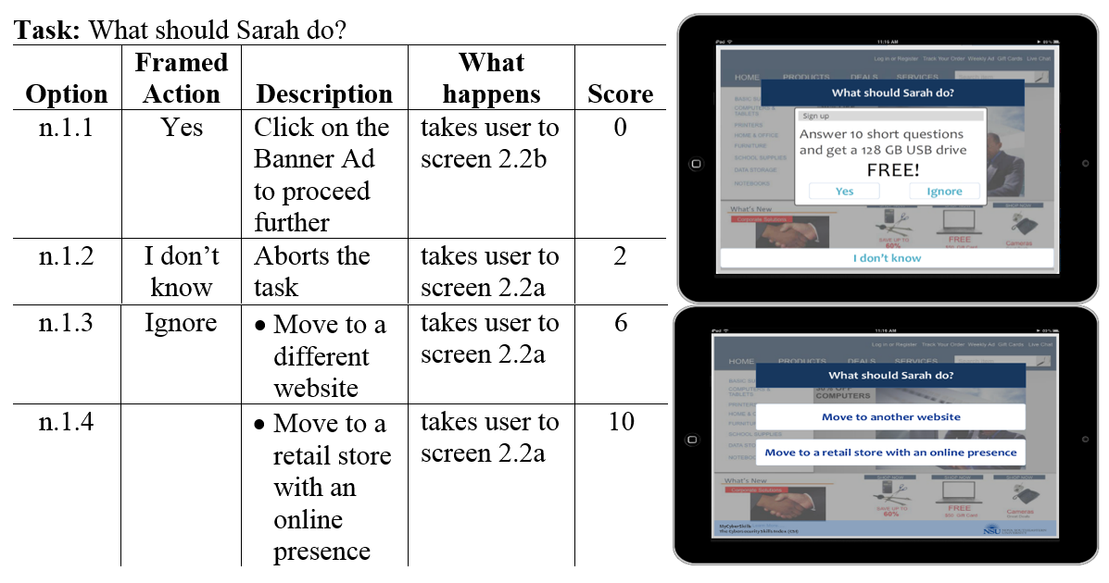
MyCyberSkills™ Prototype
Skill n – Preventing malware via non-secured Websites

Slide 26
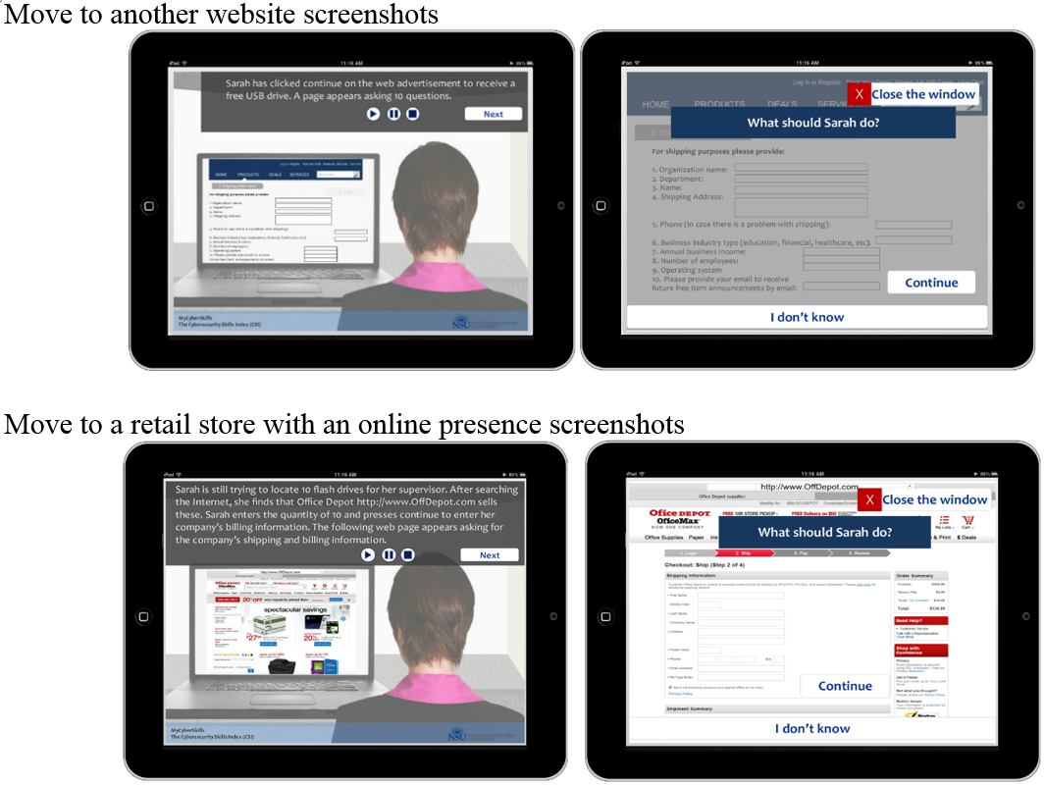
MyCyberSkills™ Prototype
Skill n – Preventing malware via non-secured Websites

Slide 27
Results (cont.)
Phase Two
  Expert Questionnaire
    Eight SMEs validated the scenarios, tasks, and scores
  Pilot Study
    21 (52.5%) non-IT professionals
    Lab managers manually calculated participant’s score, while the participant completed the iPad app prototype
    The manual calculations were then compared to the internal scores captured by the prototype

Slide 28
Results (cont.)
Phase Three
  Research Study
    Developed CSI operationalized as MyCyberSkills™
    Community approach to recruitment
      975 non-IT professionals invited
        245 (25.1%) responded
        188 (19.3%) usable for data analysis

Slide 29
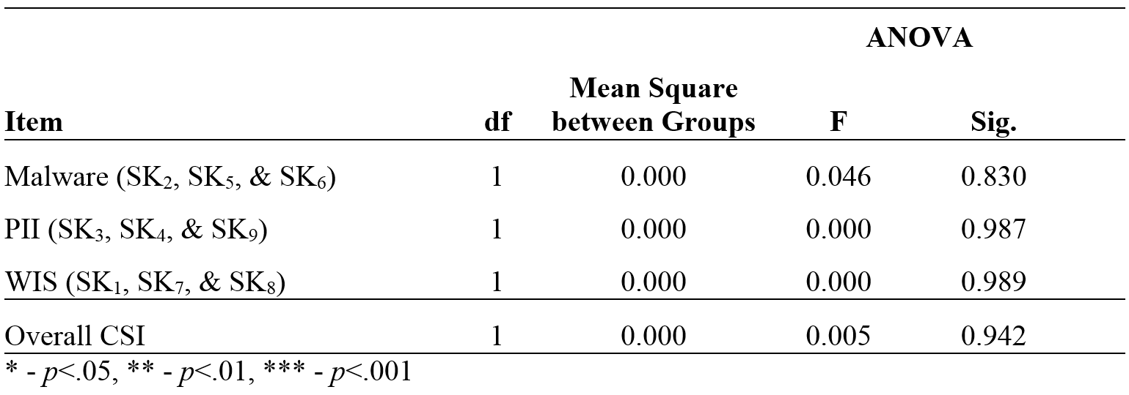
Data Analysis
ANOVA Results for Location

Slide 30
Data Analysis
Means and Standard Deviations for the Population (N=188)

Slide 31
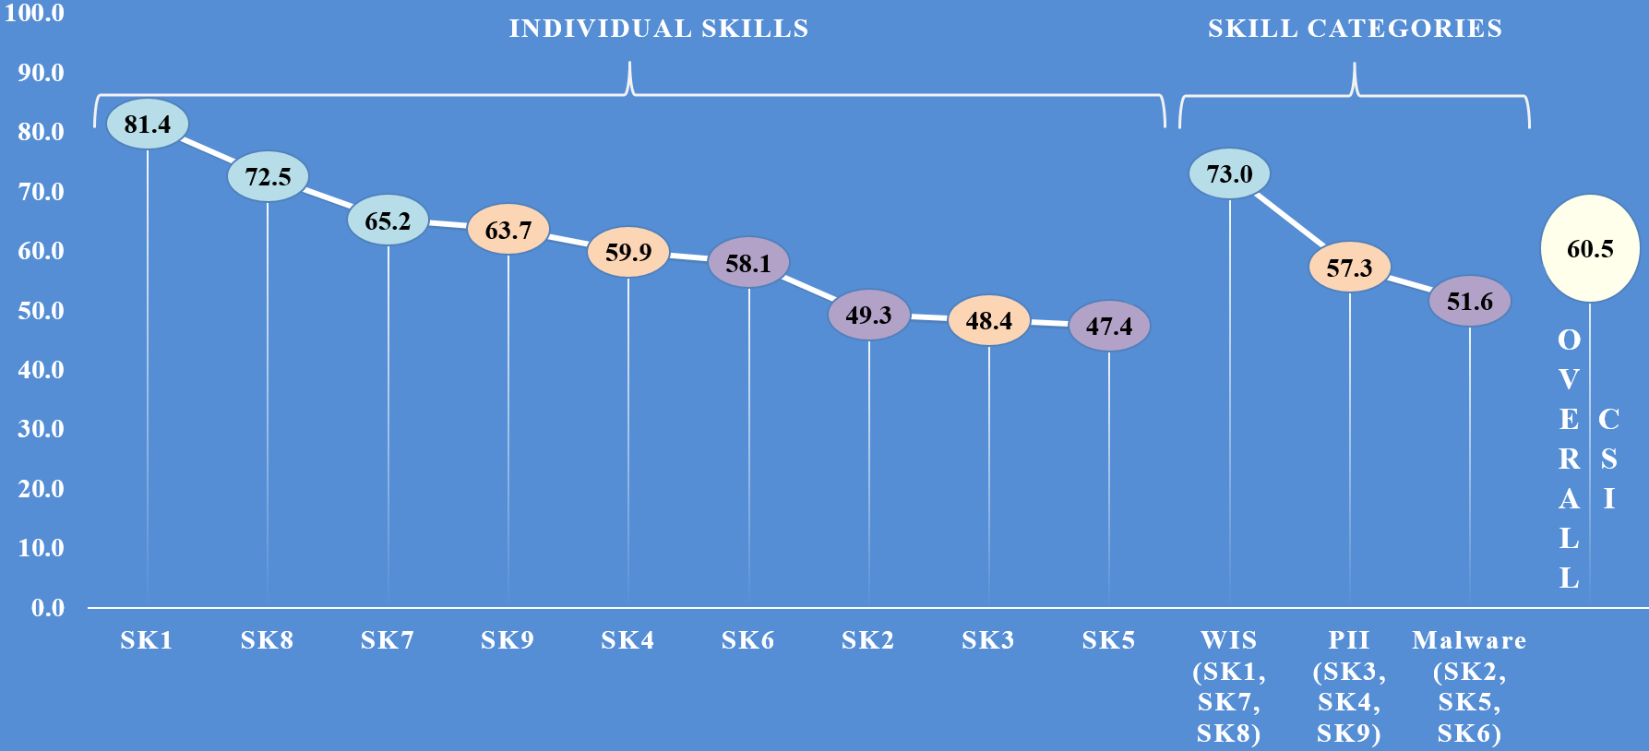
Data Analysis
Means and Standard Deviations for the Population (N=188)

Slide 32
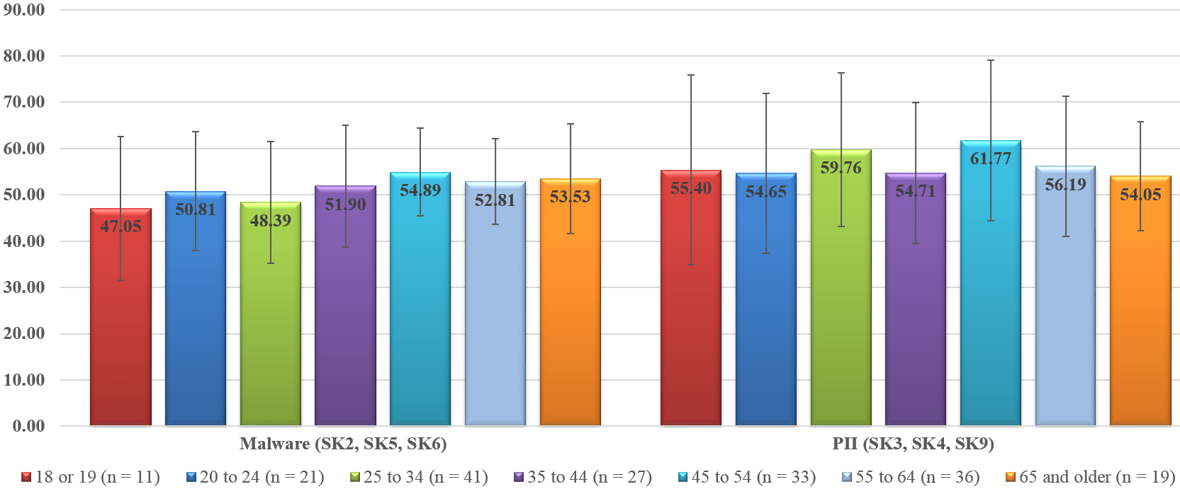
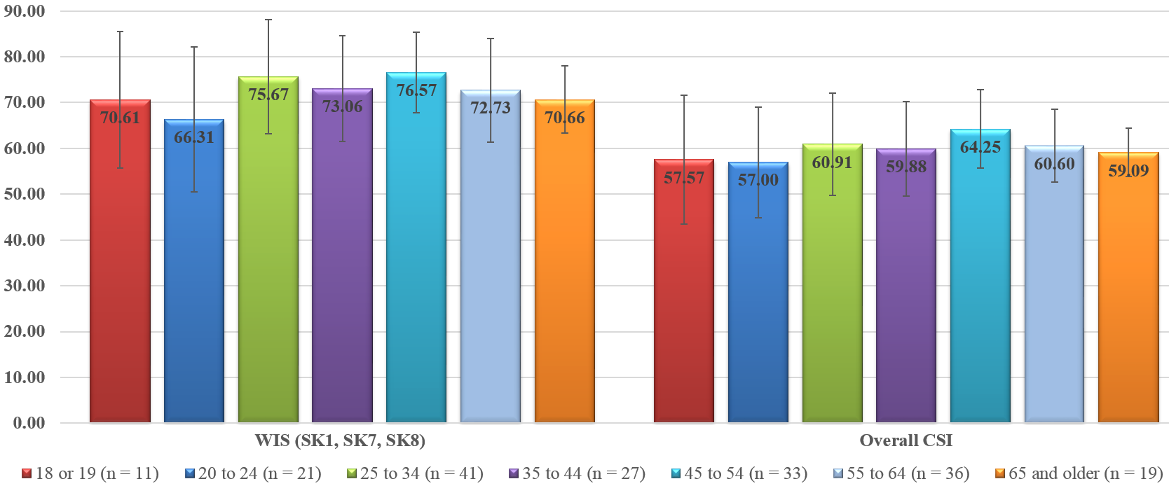
Data Analysis
Means and Standard Deviations for Age Group

Slide 33
Data Analysis
ANOVA Results for Age Group
 |  |  | ANOVA
Item | df | Mean Square between Groups | F | Sig.
Malware (SK₂, SK₅, & SK₆) | 6 | 0.019 | 1.422 | 0.208
PII (SK₃, SK₄, & SK₉) | 6 | 0.025 | 0.972 | 0.445
WIS (SK₁, SK₇, & SK₈) | 6 | 0.030 | 2.218 | 0.043 | *
Overall CSI | 6 | 0.014 | 1.478 | 0.187
* - p<.05, ** - p<.01, *** - p<.001

Slide 34
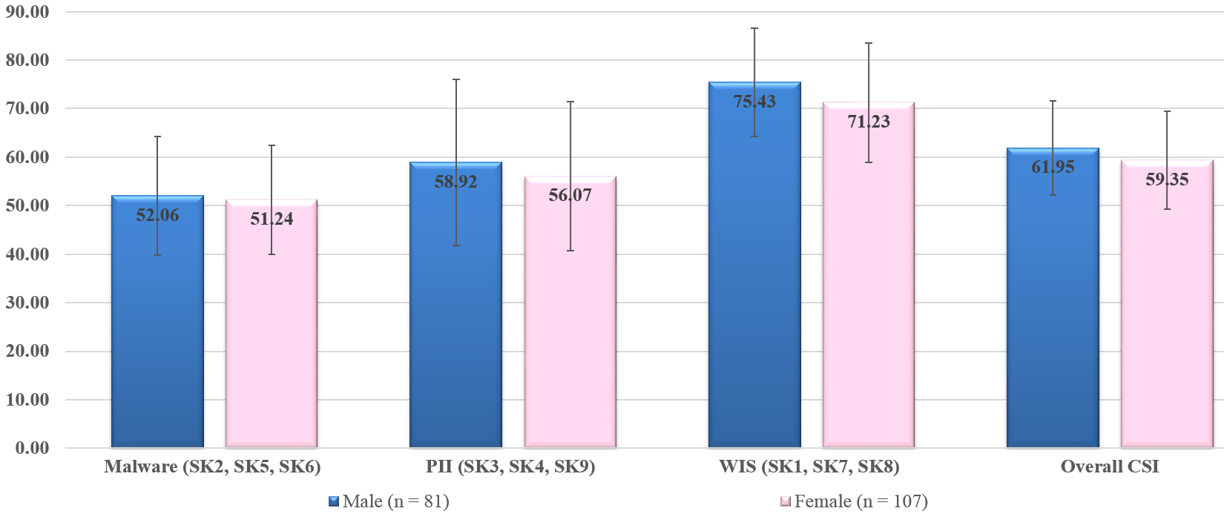
Data Analysis
Means and Standard Deviations for Gender

Slide 35
Data Analysis
ANOVA Results for Gender
 |  |  | ANOVA
Item | df | Mean Square between Groups | F | Sig.
Malware (SK₂, SK₅, & SK₆) | 1 | 0.003 | 0.224 | 0.636
PII (SK₃, SK₄, & SK₉) | 1 | 0.037 | 1.442 | 0.231
WIS (SK₁, SK₇, & SK₈) | 1 | 0.081 | 5.872 | 0.016 | *
Overall CSI | 1 | 0.031 | 3.158 | 0.077
* - p<.05, ** - p<.01, *** - p<.001

Slide 36
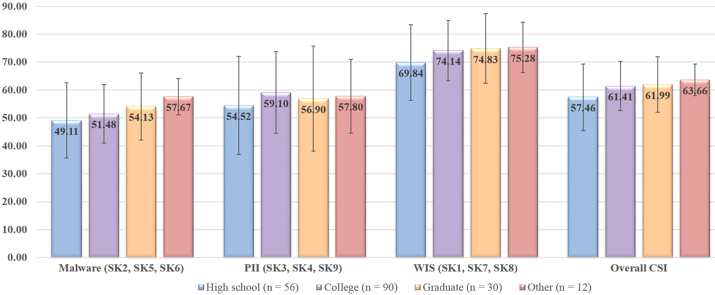
Data Analysis
Means and Standard Deviations for Education

Slide 37
Data Analysis
ANOVA Results for Education
 |  |  | ANOVA
Item | df | Mean Square between Groups | F | Sig.
Malware (SK₂, SK₅, & SK₆) | 3 | 0.032 | 2.461 | 0.064
PII (SK₃, SK₄, & SK₉) | 3 | 0.024 | 0.937 | 0.423
WIS (SK₁, SK₇, & SK₈) | 3 | 0.028 | 2.000 | 0.115
Overall CSI | 3 | 0.025 | 2.670 | 0.048 | *
* - p<.05, ** - p<.01, *** - p<.001

Slide 38
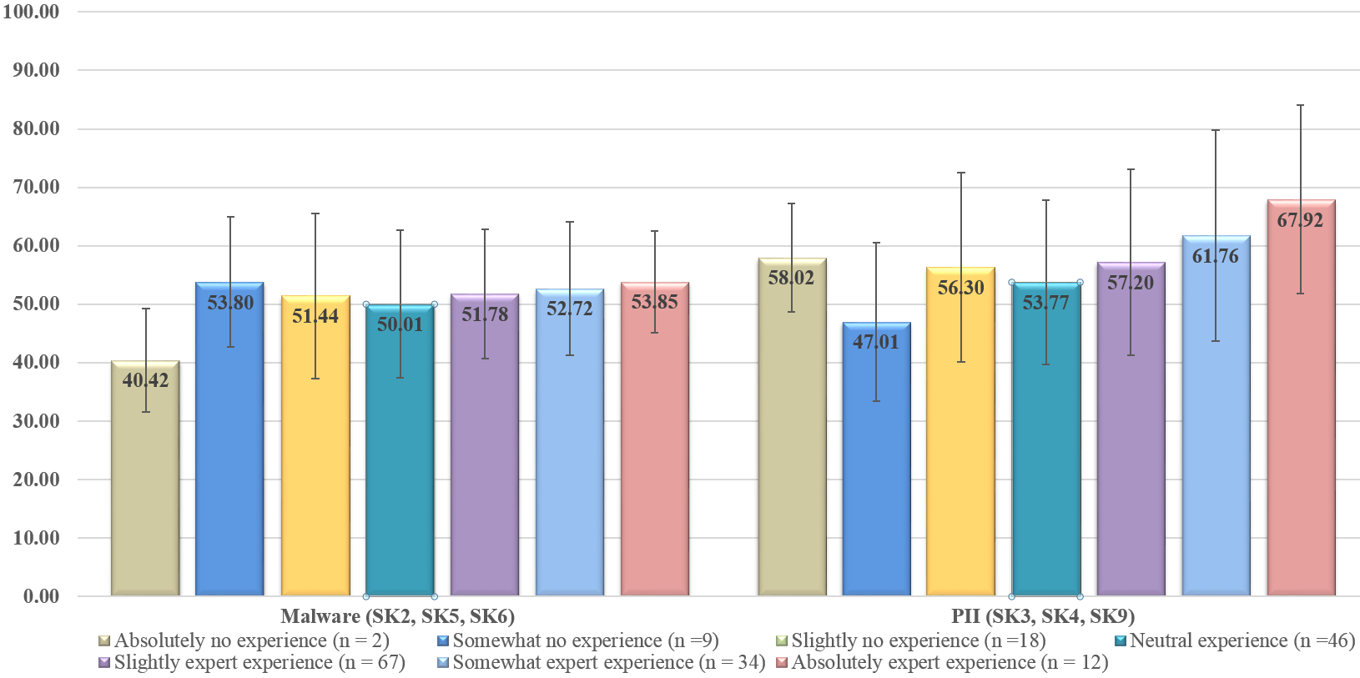
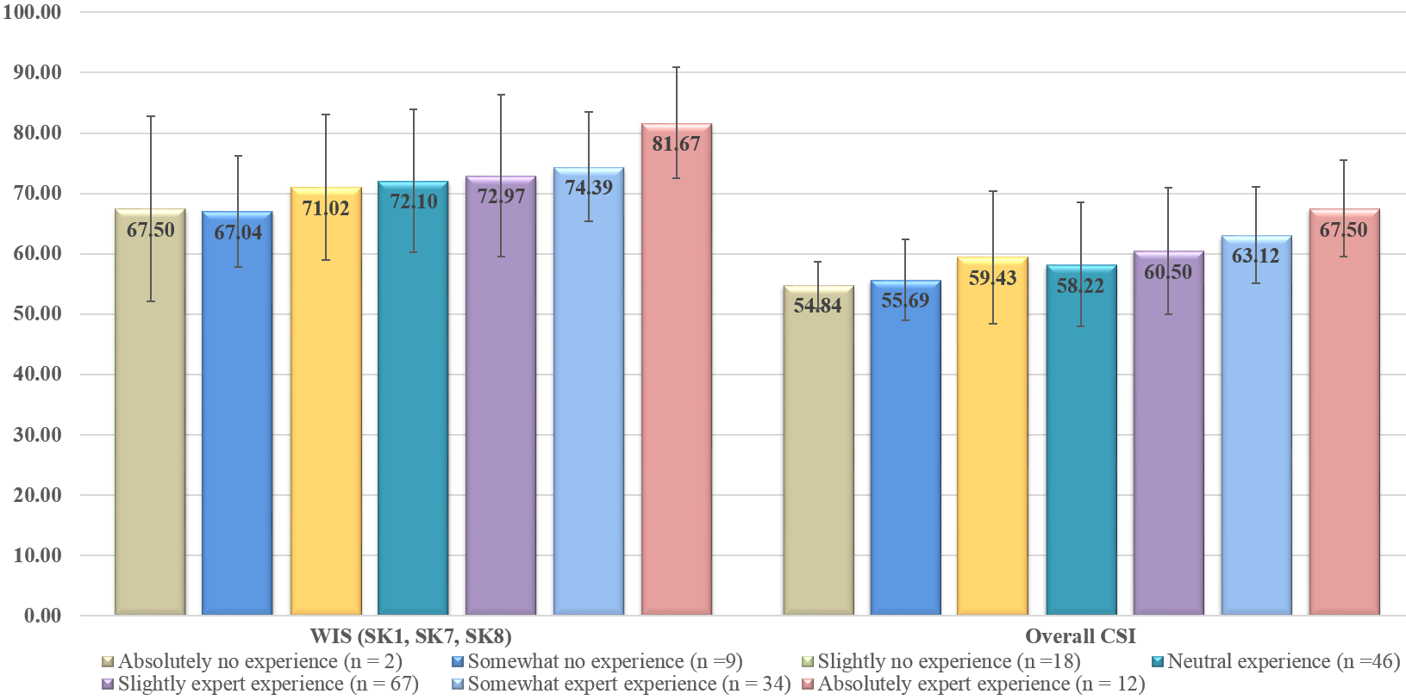
Data Analysis
Means and Std. Dev. for Experience Using Technology

Slide 39
Data Analysis
ANOVA Results for Experience Using Technology
 |  |  | ANOVA
Item | df | Mean Square between Groups | F | Sig.
Malware (SK₂, SK₅, & SK₆) | 6 | 0.008 | 0.625 | 0.709
PII (SK₃, SK₄, & SK₉) | 6 | 0.059 | 2.387 | 0.030 | *
WIS (SK₁, SK₇, & SK₈) | 6 | 0.024 | 1.746 | 0.112
Overall CSI | 6 | 0.022 | 2.361 | 0.032 | *
* - p<.05, ** - p<.01, *** - p<.001

Slide 40
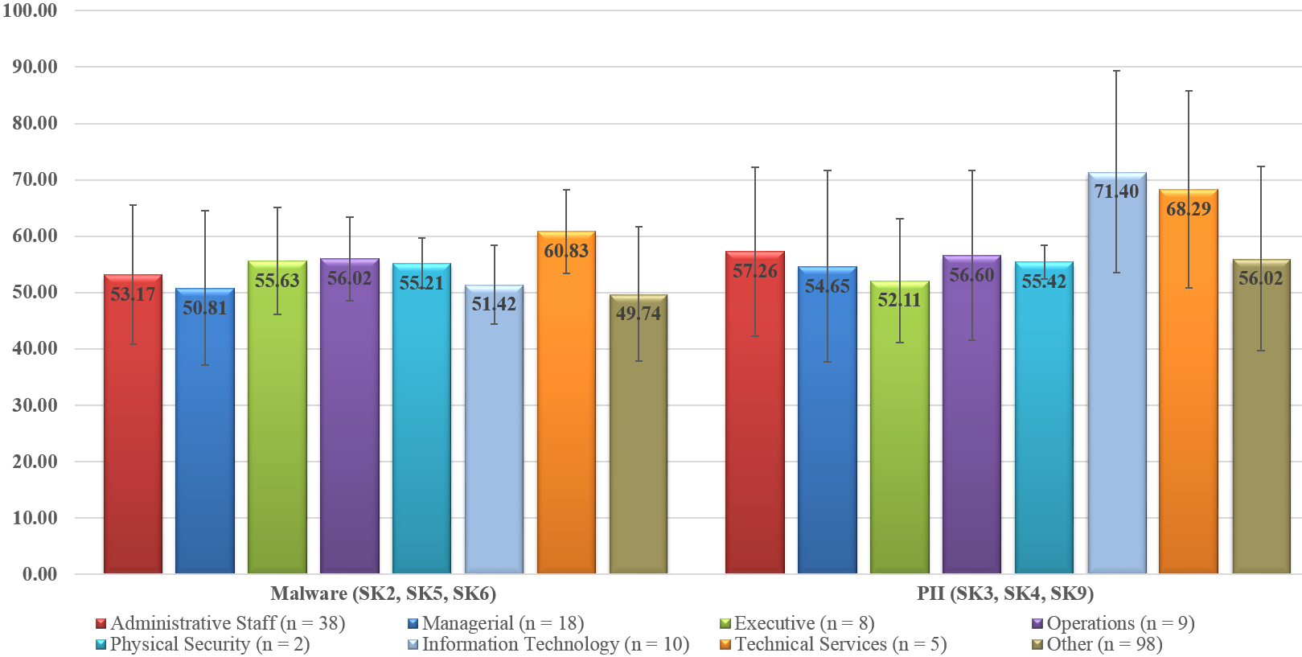
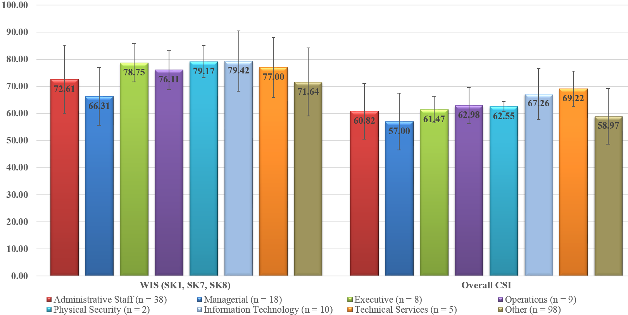
Data Analysis
Means and Standard Deviations for Job Function

Slide 41
Data Analysis
ANOVA Results for Job Function
 |  |  | ANOVA
Item | df | Mean Square between Groups | F | Sig.
Malware (SK₂, SK₅, & SK₆) | 7 | 0.017 | 1.262 | 0.271
PII (SK₃, SK₄, & SK₉) | 7 | 0.042 | 1.683 | 0.115
WIS (SK₁, SK₇, & SK₈) | 7 | 0.016 | 1.128 | 0.347
Overall CSI | 7 | 0.016 | 1.690 | 0.113
* - p<.05, ** - p<.01, *** - p<.001

Slide 42
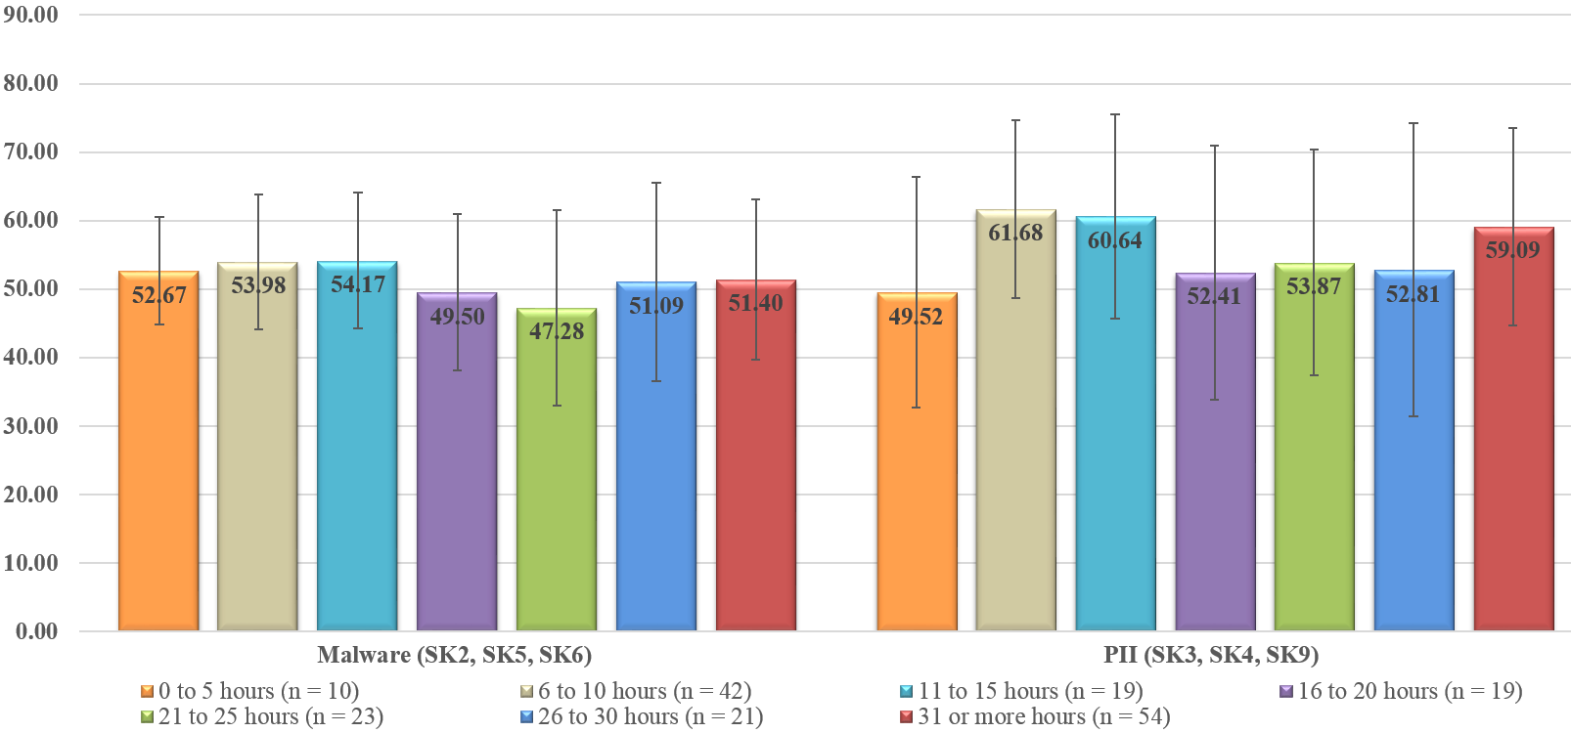
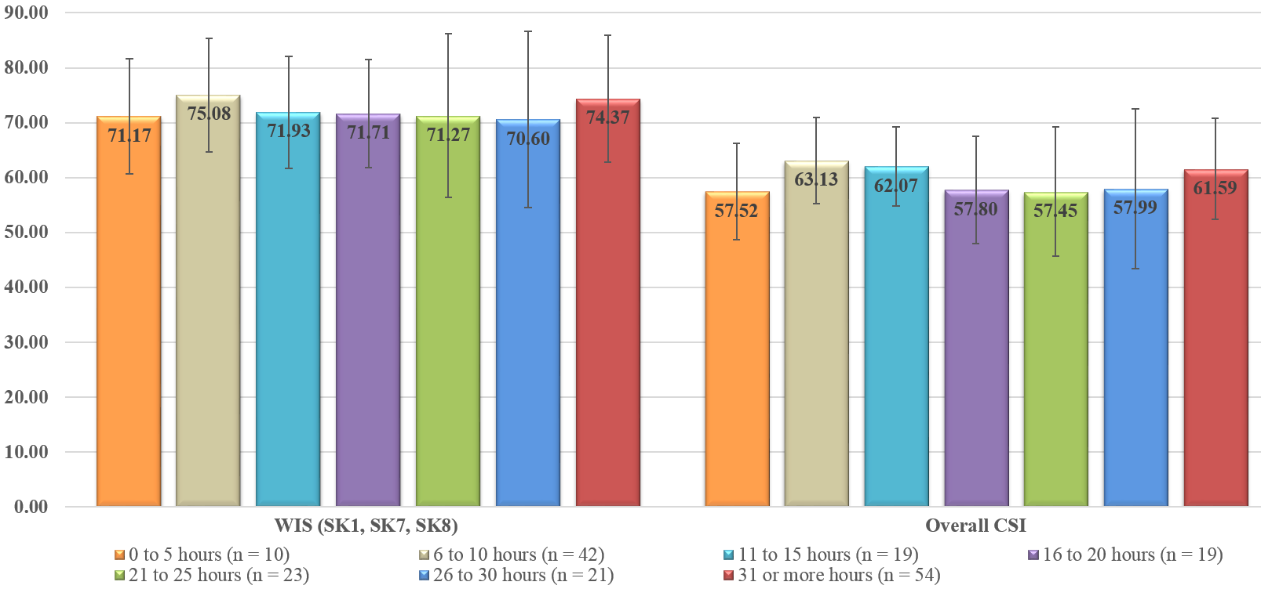
Data Analysis
Means and Std. Dev. for Hours Accessing the Internet

Slide 43
Data Analysis
ANOVA Results for Hours Accessing the Internet
 |  |  | ANOVA
Item | df | Mean Square between Groups | F | Sig.
Malware (SK₂, SK₅, & SK₆) | 6 | 0.014 | 1.099 | 0.364
PII (SK₃, SK₄, & SK₉) | 6 | 0.049 | 1.939 | 0.076
WIS (SK₁, SK₇, & SK₈) | 6 | 0.009 | 0.648 | 0.691
Overall CSI | 6 | 0.016 | 1.663 | 0.132
* - p<.05, ** - p<.01, *** - p<.001

Slide 44
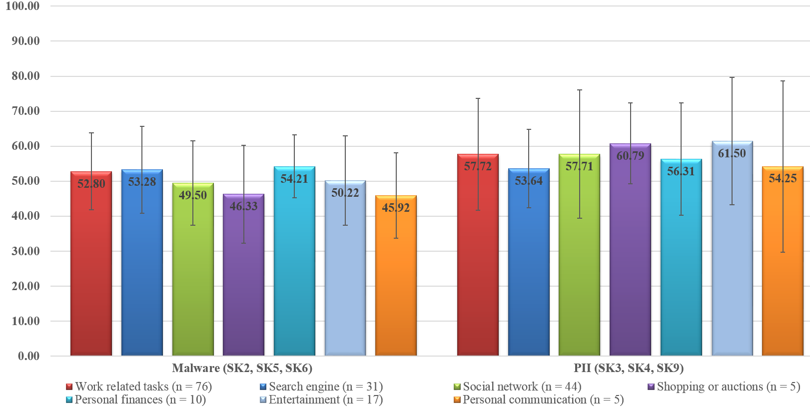
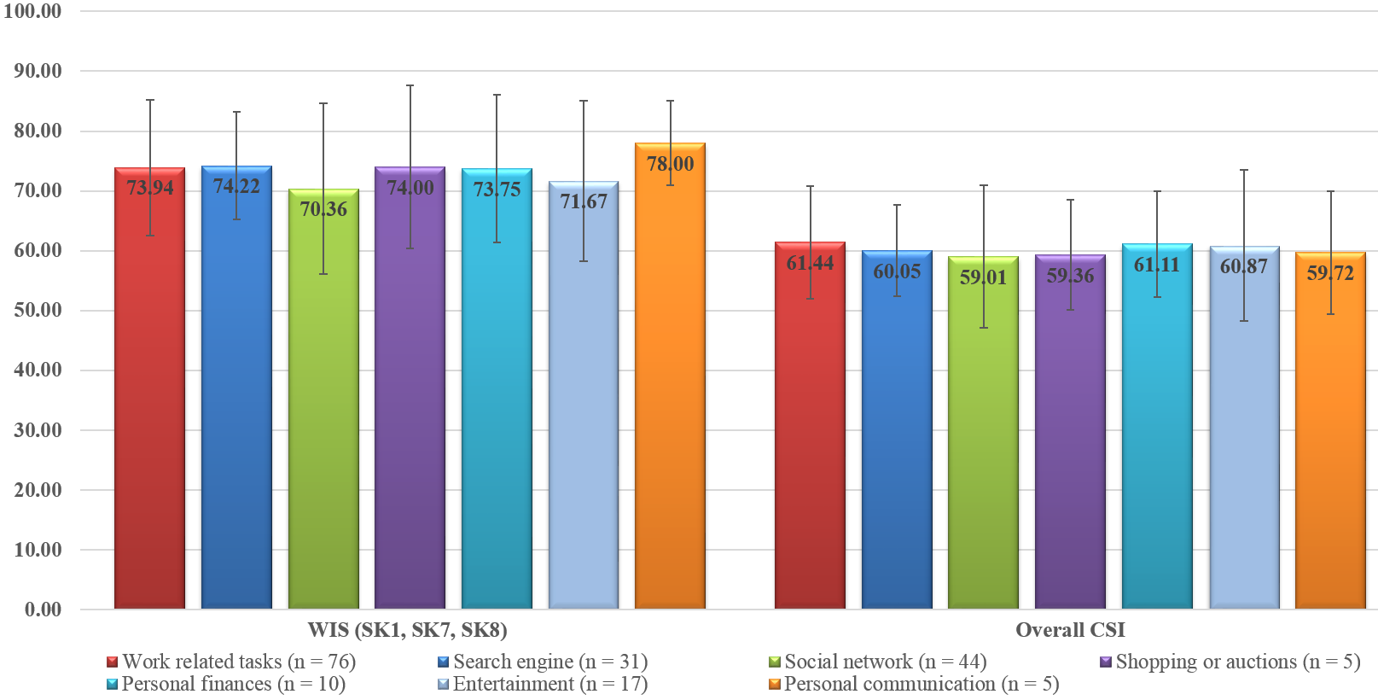
Data Analysis
Means and Std. Deviations for Primary Online Activity

Slide 45
Data Analysis
ANOVA Results for Primary Online Activity
 |  |  | ANOVA
Item | df | Mean Square between Groups | F | Sig.
Malware (SK₂, SK₅, & SK₆) | 6 | 0.013 | 0.969 | 0.447
PII (SK₃, SK₄, & SK₉) | 6 | 0.014 | 0.537 | 0.779
WIS (SK₁, SK₇, & SK₈) | 6 | 0.009 | 0.678 | 0.667
Overall CSI | 6 | 0.003 | 0.304 | 0.934
* - p<.05, ** - p<.01, *** - p<.001

Slide 46
Data Analysis
RQ1: Literature review and expert panel
RQ2: Literature review and expert panel
RQ3: Validating CSI benchmarking index
  Expert panel and pilot-test
RQ4: Test the level of cybersecurity skills
RQ5: Descriptive and one-way Analysis of Variance
  Age
  Gender
  Education
  Job function
  Experience using technology
  Primary activity
  Hours online

Slide 47
Contributions & Implications
Notable to the IS body of knowledge
Provides insight for researchers and practitioners
  Understanding an employee’s cybersecurity skills level is critical to securing information and the systems that stores it
  Assessing the cybersecurity skills level of non-IT professionals
  Assist in the mitigation of threats due to vulnerabilities and breaches caused by non-IT professionals

Slide 48
Future Research
Widen the recruitment community to increase generalizability
Specific population to determine if the CSI level of a supervisor affects the CSI of a subordinate
Organizational culture effects on CSI level of its employees
Investigation of the effects of behaviors (i.e., curiosity, boredom, etc.) or emotions
Replicated as a video presentation using an audience response system

Slide 49
Thank you . . .
Questions?

